Slide 1


Dimensionality Reduction
Presented by : Gaurav Chauhan
Hetvi Mavani
Rohit Jire

Slide 2
Agenda
1. Introduction
1.1 What is Dimensionality Reduction?
1.2 How Curse of Dimensionality Impact Machine Learning Algorithms?
3. PCA (Principal Component Analysis)
3.1 How does PCA works?
3.2 Explaining Variance
4. t-SNE (t-distributed Stochastic Neighbor Embedding)
4.1 How does t-SNE works?
4.2 Hyperparameter - Perplexity
6. Comparison
5. UMAP (Uniform Manifold Approximation and Projection)
3.3 Problem with PCA
4.3 t-SNE Practical Examples
5.1 How UMAP works?
5.2 Hyperparameter
Neighbor
Minimum distance
5.3 Why UMAP is better than t-SNE
2. Types of Dimensionality Reduction
2.1 Feature Selection
2.2 Feature Extraction

Slide 3
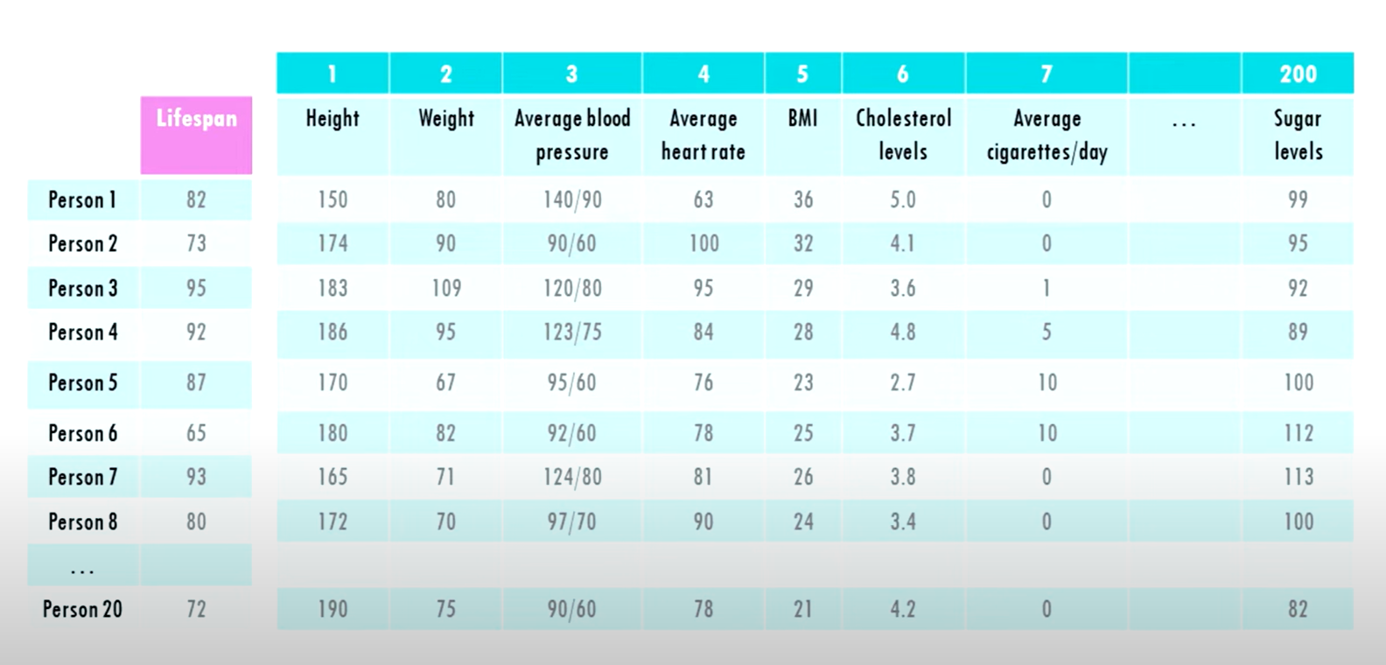
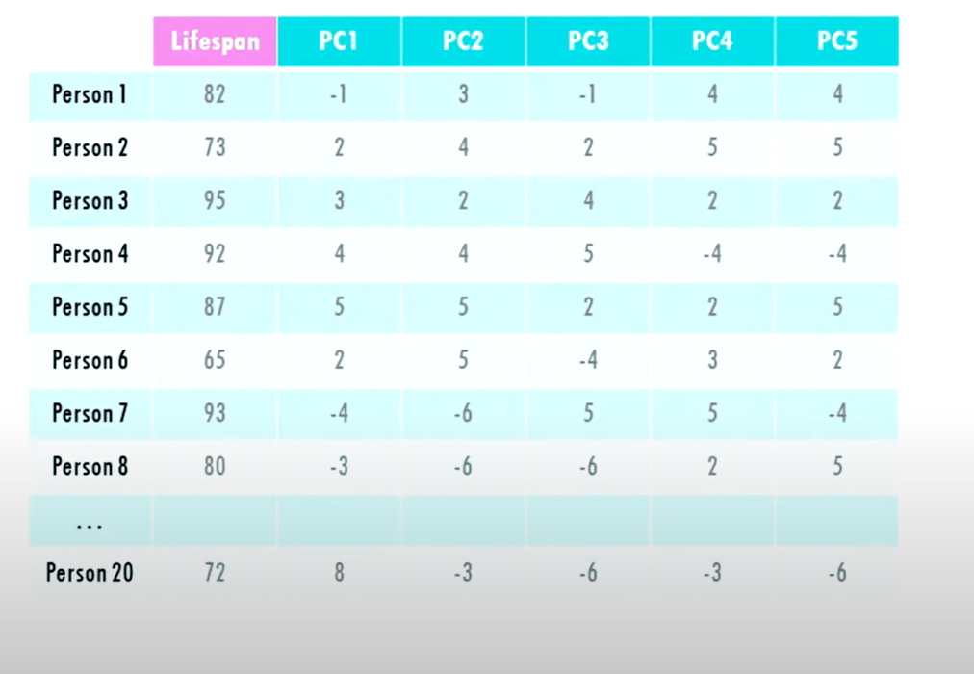
What is Dimensionality Reduction?
Reducing the number of input features in a dataset while retaining meaningful information.
We can’t visualize so many dimensions all at once
Simply adding more features to a dataset doesn’t always improve performance and can make training harder.
Curse of Dimensionality

Slide 4
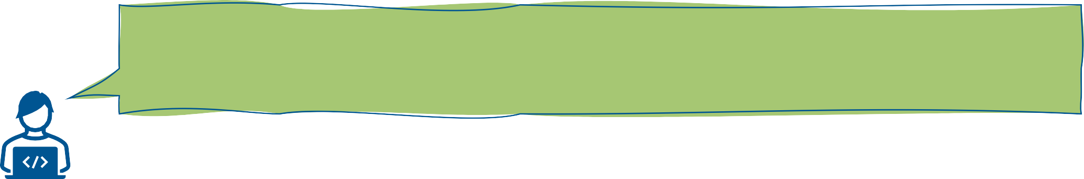
How Curse of Dimensionality Impact Machine Learning Algorithms?
Higher Computational Complexity: As dimensions increase, the number of computations needed grows exponentially.
Redundant Features: Many features may not add any new information but increase complexity unnecessarily.
Overfitting: More features increase the risk of overfitting because the model may learn noise instead of the actual patterns in the data.
We need to think about this problem!

Slide 5
Types of Dimensionality Reduction
Feature Selection
Feature Extraction
Forward Selection
Backward Elimination
PCA

Slide 6
Agenda
1. Introduction
1.1 What is Dimensionality Reduction?
1.2 How Curse of Dimensionality Impact Machine Learning Algorithms?
3. PCA (Principal Component Analysis)
3.1 How does PCA works?
3.2 Explaining Variance
4. t-SNE (t-distributed Stochastic Neighbor Embedding)
4.1 How does t-SNE works?
4.2 Hyperparameter - Perplexity
6. Comparison
5. UMAP (Uniform Manifold Approximation and Projection)
3.3 Problem with PCA
4.3 t-SNE Practical Examples
5.1 How UMAP works?
5.2 Hyperparameter
Neighbor
Minimum distance
5.3 Why UMAP is better than t-SNE
2. Types of Dimensionality Reduction
2.1 Feature Selection
2.2 Feature Extraction

Slide 7
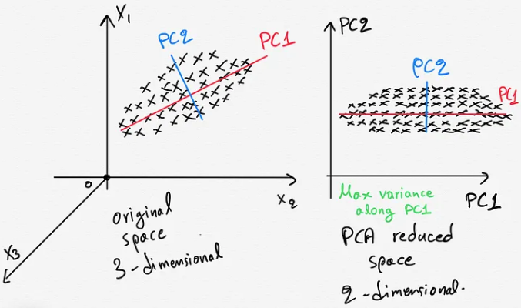
Principal Component Analysis (PCA)
The basic idea behind PCA is to identify patterns in the relationships between variables, and to represent these patterns in terms of a smaller number of variables, called principal components.

Slide 8
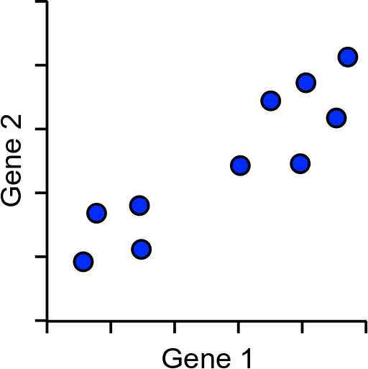
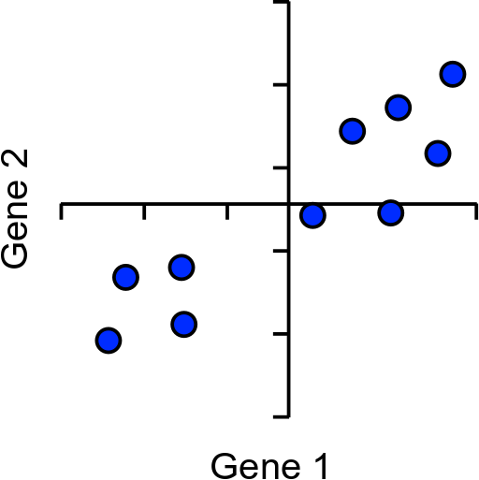
How does PCA work?
Simple example using 2 genes and 10 cells
Center the points

Slide 9
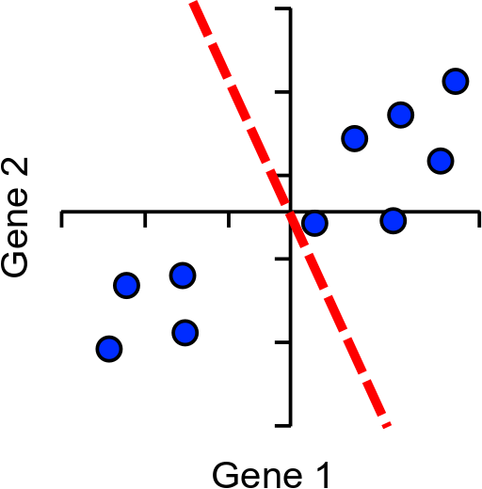
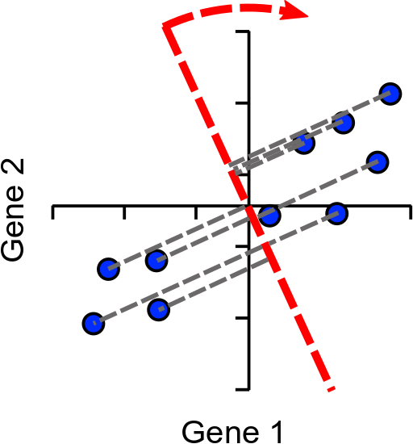
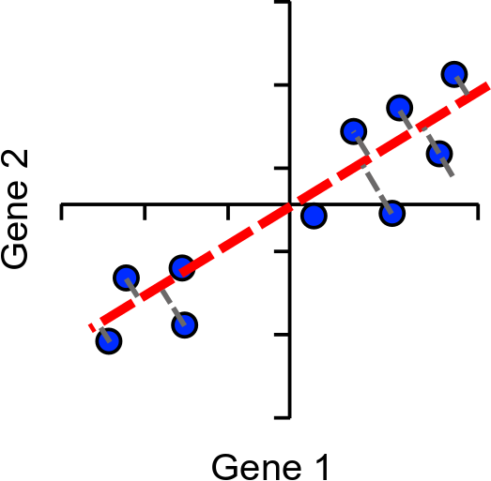
How does PCA work?
Find line of best fit, passing through the origin

Slide 10
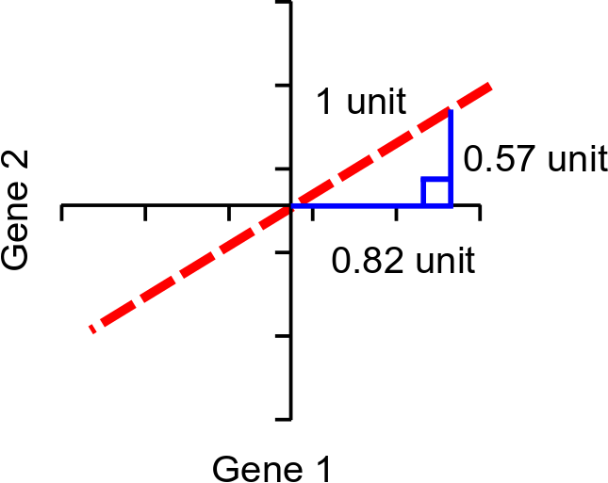
Assigning Loadings
Single Vector or
‘eigenvector’
Loadings:
Gene1 = 0.82
Gene2 = 0.57
Higher loading equals more influence on PC

Slide 11
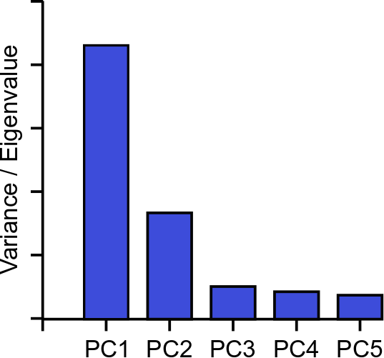
Explaining Variance (Scree Plot)
Each PC always explains some proportion of the total variance in the data.
Between them they explain everything
PC1 always explains the most
PC2 is the next highest etc.
Since we only plot 2 dimensions, so we can plot those PC whose variance is nearly equal to 90%.

Slide 12
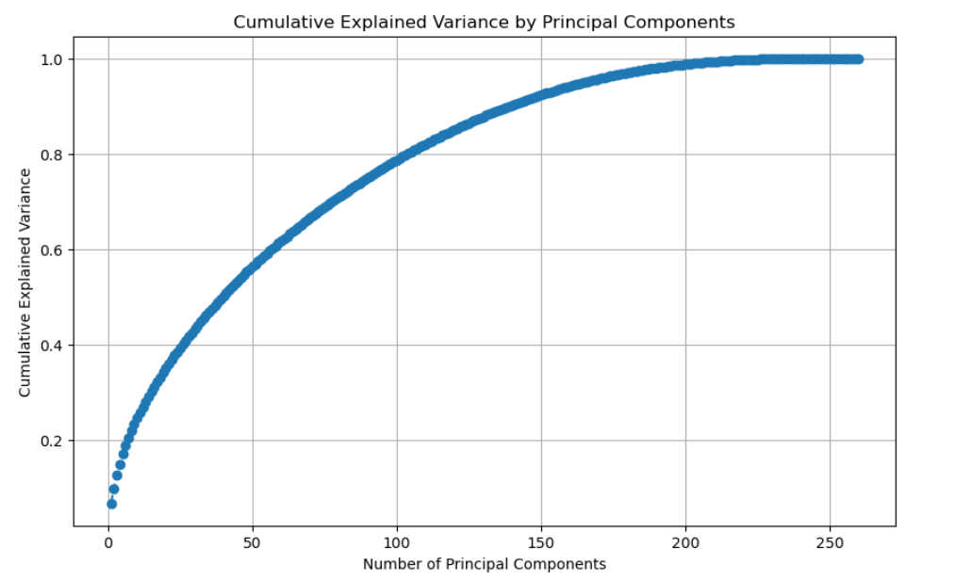
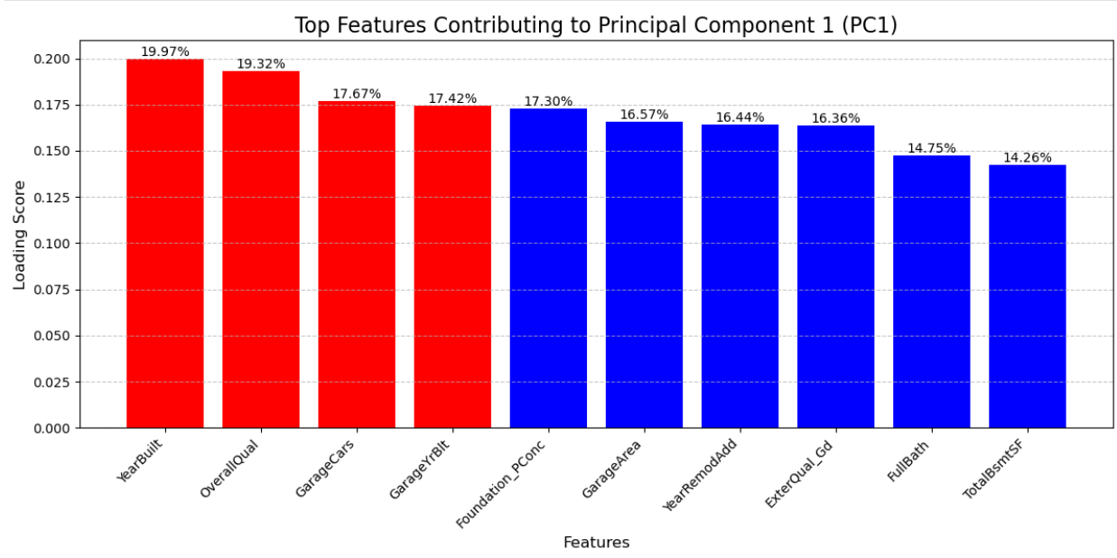
PCA Example
House Price Prediction Data
81 Columns
Converting Categorical Data
260 columns
https://www.kaggle.com/competitions/house-prices-advanced-regression-techniques/data

Slide 13
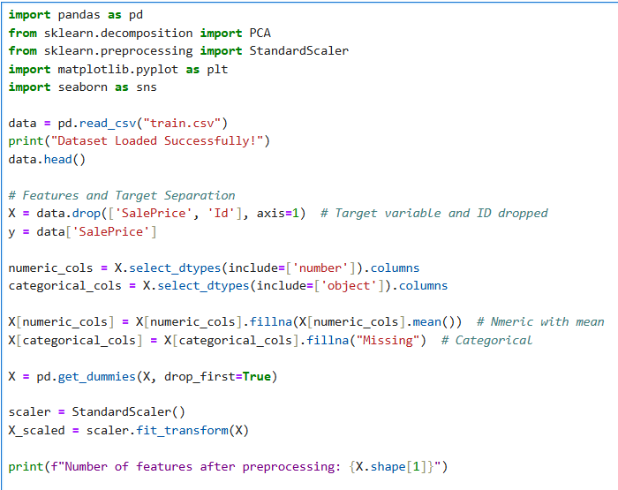
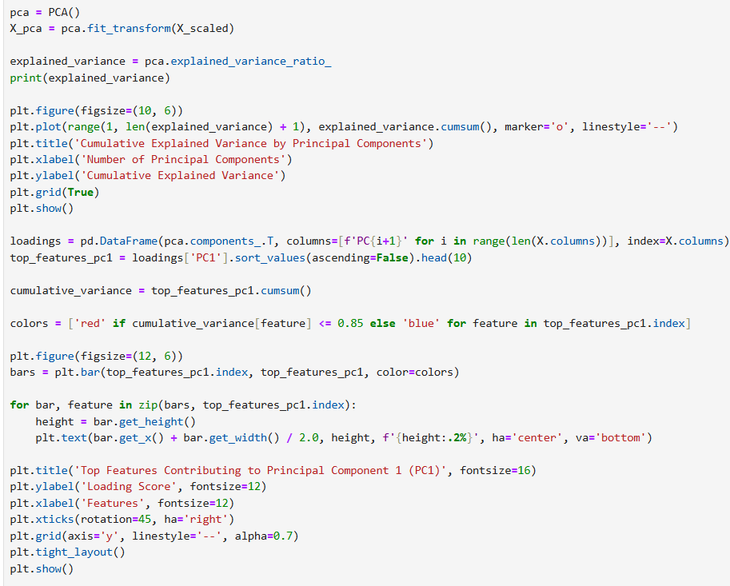
PCA Example

Slide 14
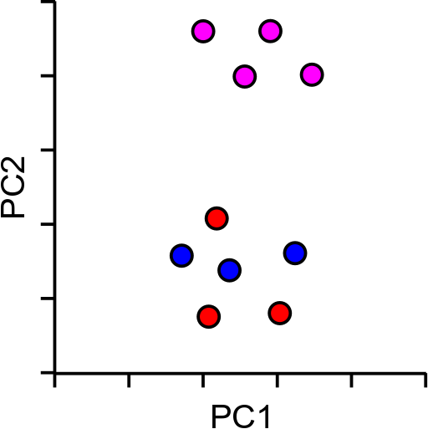
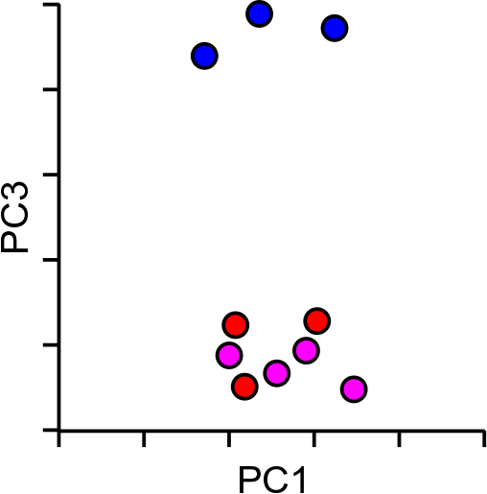
Problem with PCA
Works best with linear data

Slide 15








t-SNE
t-SNE (t-distributed Stochastic Neighbor Embedding) is a machine learning algorithm that visualizes high-dimensional data.
It’s a non-linear dimensionality reduction technique that can separate data that can’t be separated by a straight line.
t-SNE preserves the local structure of the data by keeping similar data points close together in a lower-dimensional space.
t-SNE would transform this
t-SNE find a way to project data into a low dimensional space so that the clustering in the high dimensional space is preserved.

Slide 16
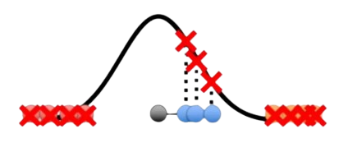
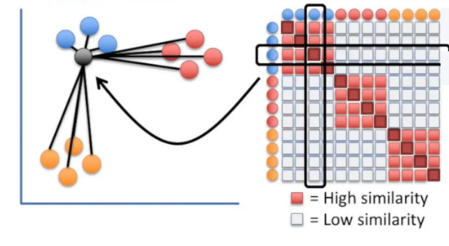
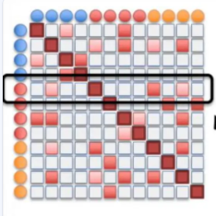
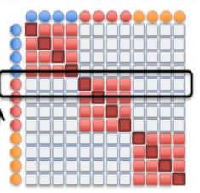
How t-SNE works
T-Distributed Stochastic Neighbour Embedding
Lower Dimension (Start)
Lower Dimension (End)
Same
T-Distributed
Stochastic Neighbour
Embedding
We want to make this both matrix same in a way that captures the essence of the data while preserving its neighbor relationships
Measure the distance between all of the points
Plot them on a curve

Slide 17



How t-SNE works
Here’s a basic 2-D Scatter Plot
1. Put the points in a random order.
2. Figure out where to move the first point
- Some points attract.
- Some points repel.
3. Iterate 2nd point till we get the final result.
-Stop after distances have converged
iterations
iterations

Slide 18
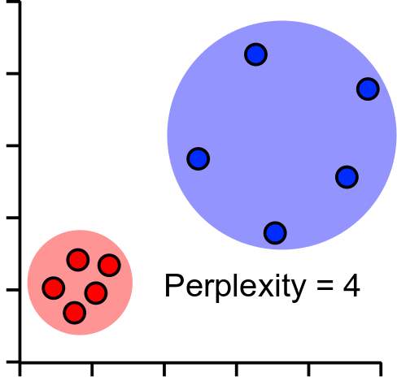
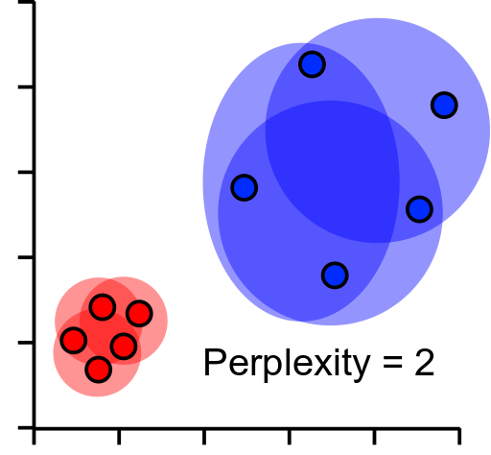
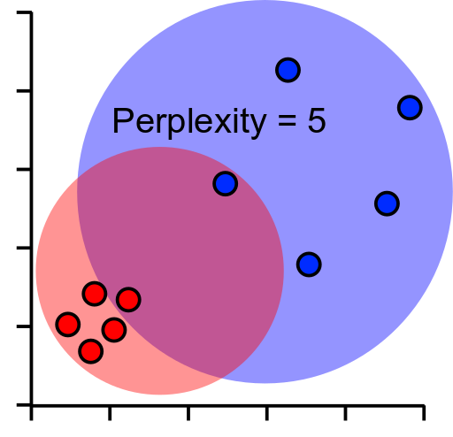
Perplexity - Hyperparameter
Perplexity is a key hyperparameter in t-SNE that controls the balance between focusing on local vs. global structure in the data. It influences how t-SNE defines "neighborhoods" when calculating the similarities between data points in high-dimensional space.

Slide 19
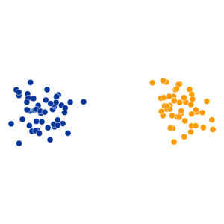
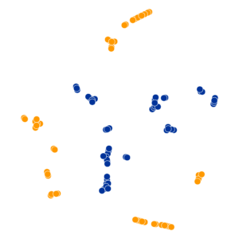
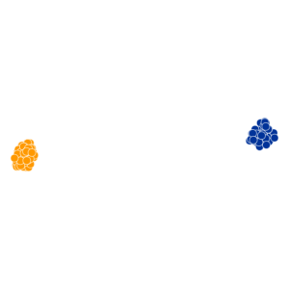
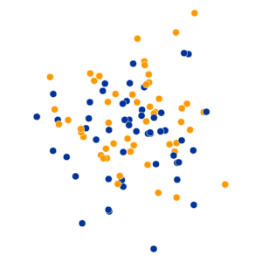

t-SNE Perplexity Examples
Original
50 data points
Perplexity = 2
Perplexity = 30
Perplexity = 100
50 data points
Perplexity Settings Matter

Slide 20
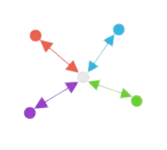
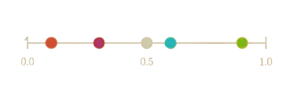

UMAP (Uniform Manifold Approximation and Projection)
Higher Dimensionality
Lower Dimensionality
How
PCA – Maximize Variance (Linear Data)
t-SNE – Probability Distribution (Local Similarity)
UMAP – Graph based (Local + Global)

Slide 21
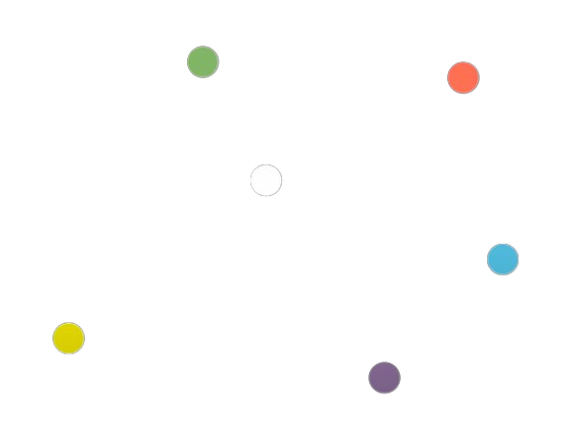
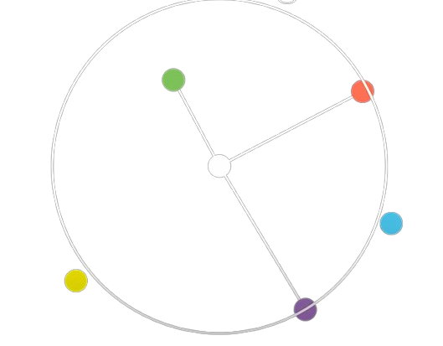
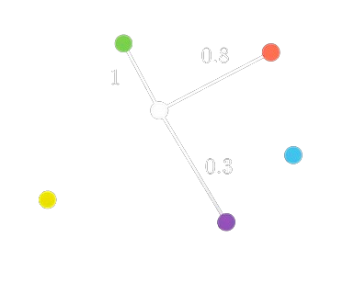
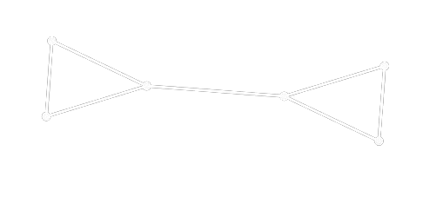
How UMAP works
Create a Graph
Nodes – Data points
Edges – Connect neighbouring points
2. Find the nearest neighbour
3. Weights reflects the strength of similarity
4. Random Low dimensional graph
UMAP minimizes the difference between the high-dimensional and low-dimensional graphs.
It ensure:
Points that are close in high dimensions remain close in the lower-dimensional space.
Points that are far apart in high dimensions remain far apart.

Slide 22
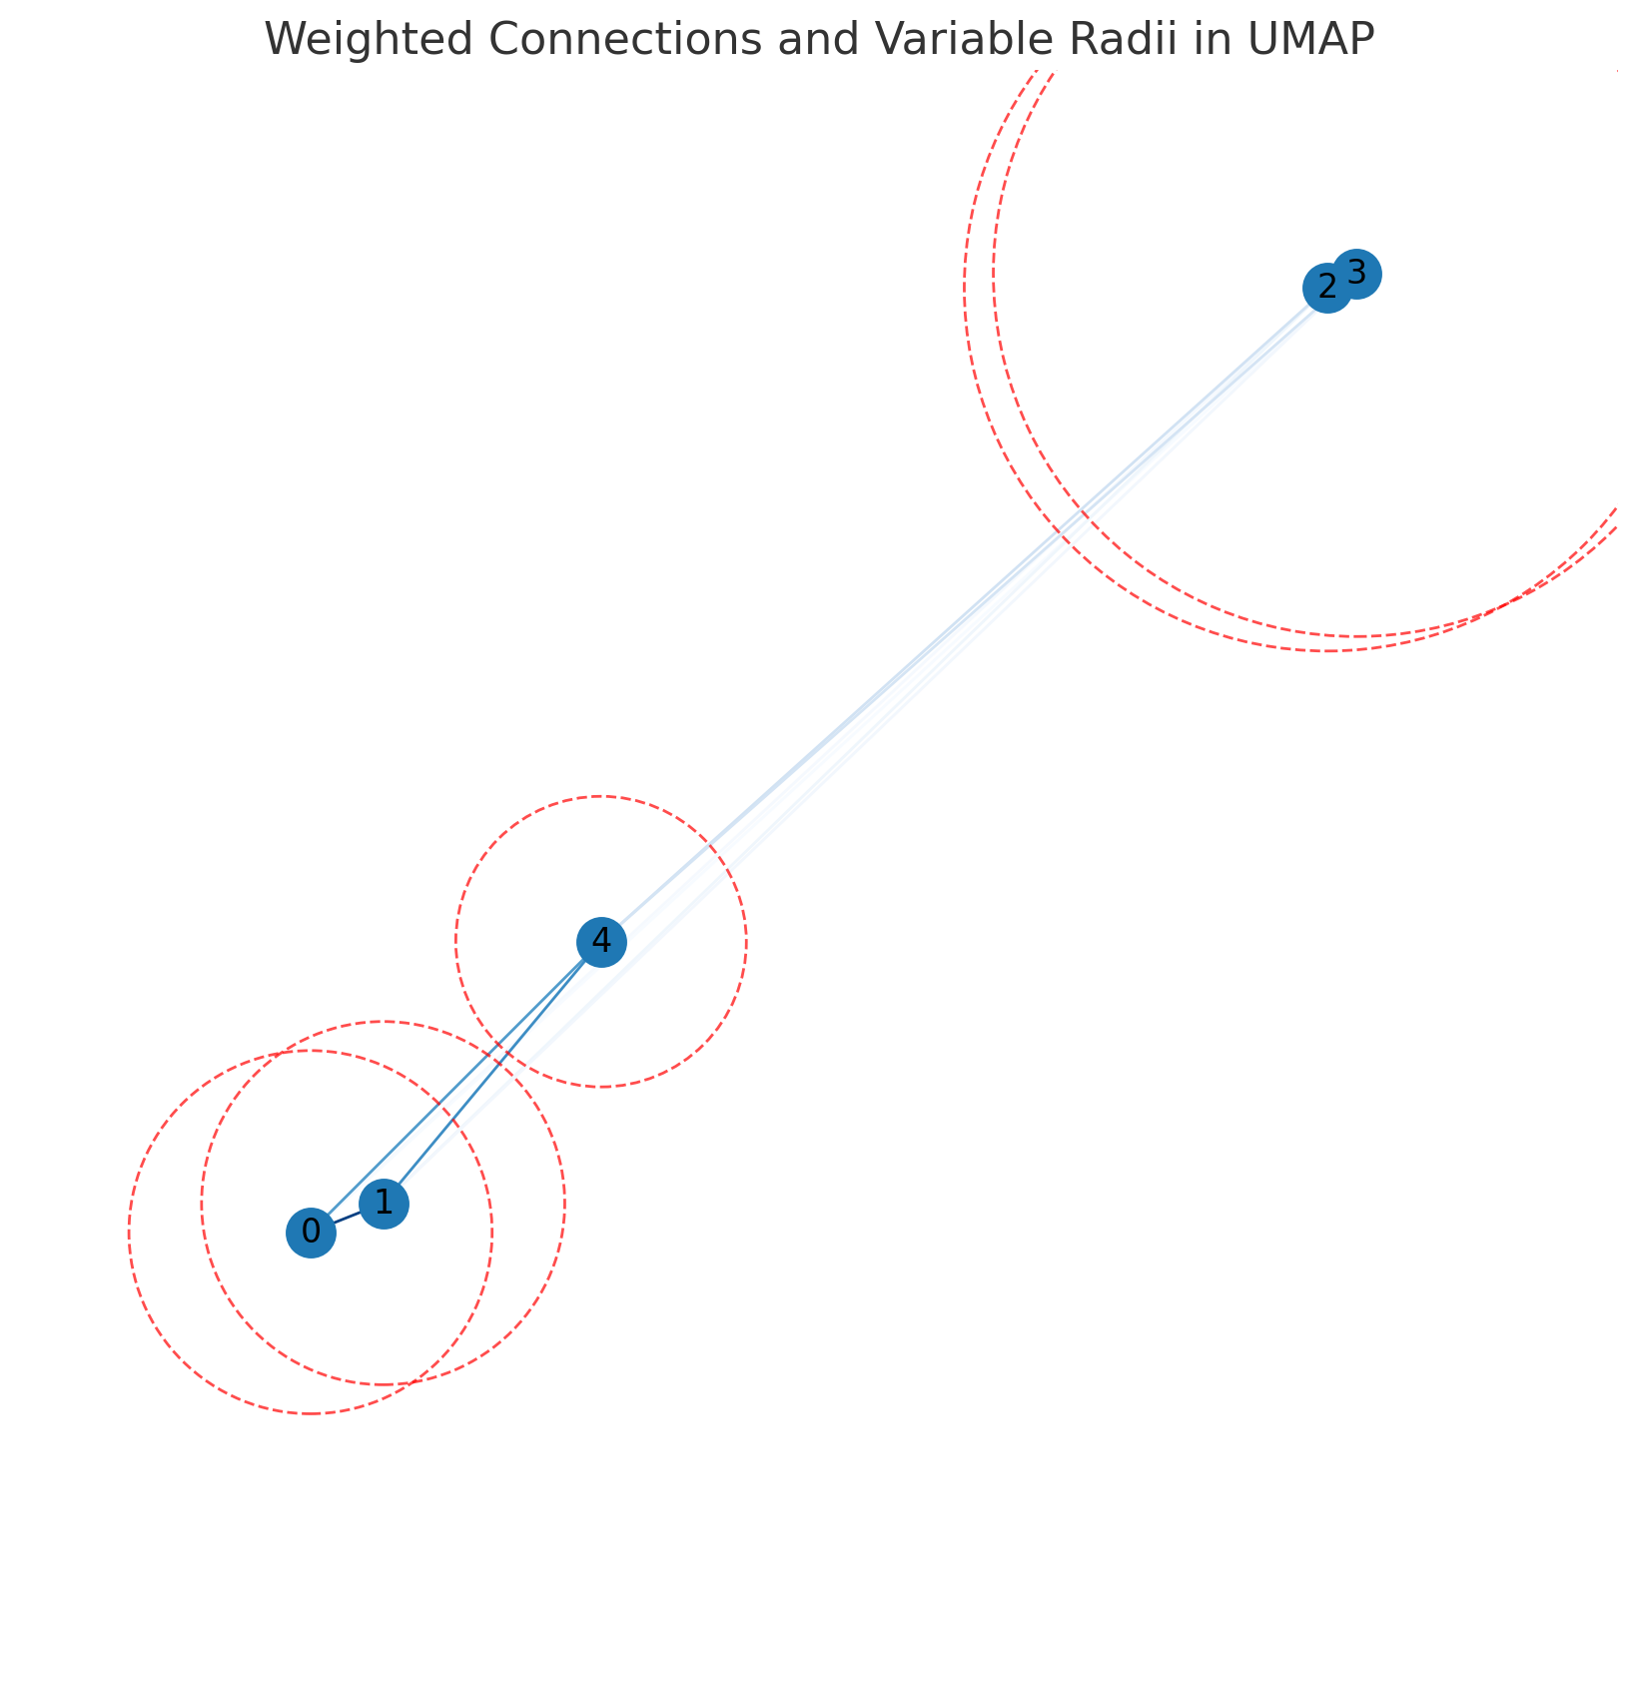
How UMAP works
Weighted Connections : - Assigning weights based on their proximity. Points closer together get stronger connections.
Variable Radius
- Instead of a fixed distance, UMAP uses a variable radius:
- Larger radius for sparse regions to ensure connectivity.
- Smaller radius for dense regions to avoid excessive overlap.
Larger Radius
(Sparse Region)
Smaller Radius
(Dense Region)

Slide 23
Hyperparameters in UMAP
n_neighbor:
Controls the size of the neighborhood for each point.
Small values preserve local structure (fine details)
Large values emphasize global structure (big picture).
min_dist:
Determines how tightly points are clustered in the low-dimensional space.
Lower values: Tighter, denser clusters.
Higher values: More spread-out representation.
What’s the difference between t-SNE and UMAP then?

Slide 24
Why is UMAP better
Efficient Neighbor Search:
UMAP uses an advanced nearest-neighbor search algorithm to quickly find similar points in the high-dimensional space.
t-SNE performs a pairwise distance calculation for all points.
Graph Optimization:
UMAP builds a graph-based representation of the data in high dimensions and optimizes it globally in fewer steps.
t-SNE uses a more computationally expensive probability distribution matching process.
Scalability:
UMAP can handle millions of points efficiently due to its streamlined optimization process.
t-SNE struggles with large datasets, making it less scalable.

Slide 25
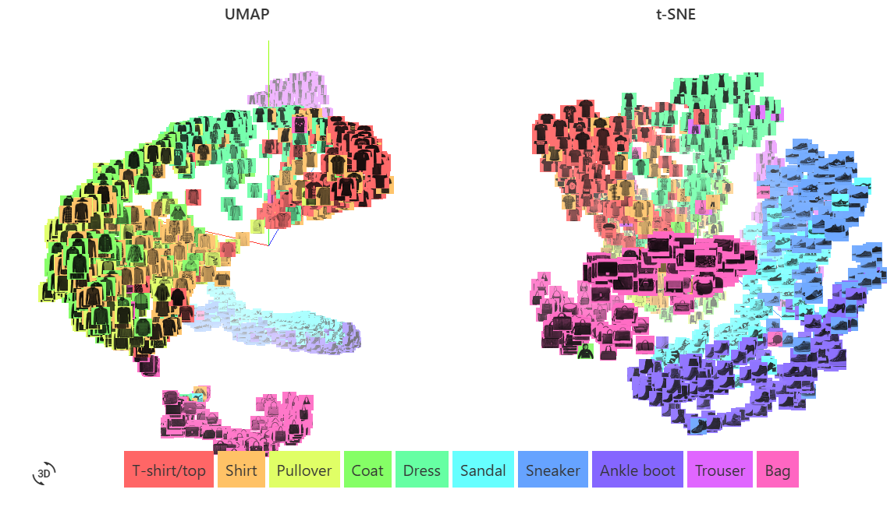

Comparison
Understanding Live
784-dimensional Fashion MNIST dataset

Slide 26
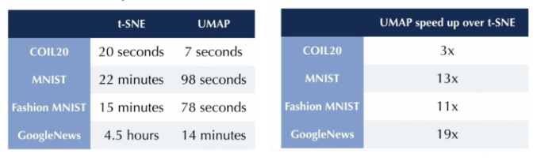
Comparison
Aspect | PCA | t-SNE | UMAP
Approach | Linear (variance) | Probabilistic (local similarity) | Graph-based (local + global)
Speed | Fast | Slow | Fast
Structure Preserved | Global | Local Only | Local + Global
https://meta.caspershire.net/umap/

Slide 27
THANK YOU ☺

